Slide 1

Midnight Blood
Stalk the streets
hunting unwitting villagers,
Before the rising sun
foils your reign of carnage!

Slide 2

Team - Hivemind Productions
Art
Jamie Appleby
Sarah Hocking
Mark Hanks
Programming
Fredrick Bancan
Sam Nagy
Andrew Osborn
Production
Grant Bailey
Notes:
Changed “get high scores!” to “survive as many nights as you can” - fred
Changed “authorities will dispatch you with fire!” to “if you are reached by the authorities, you will be killled” - fred
Changed “local church” to “local abandoned church” - fred
Changed “level” to “night” - fred

Slide 3

Elevator Pitch
You are a vampire, waking in the evening from your coffin in the mausoleum of the local abandoned church.
You are hungry for blood with a thirst that is displayed on screen as a depleting vitality meter that must be refilled by attacking villagers.
You must be stealthy, and only attack your victims from behind or they will run and alert the authorities.
If you are reached by the authorities, you will be killed!
When the bell tolls, race back to the safety of your crypt to complete the night.
Survive as many nights as you can.
Notes:
Changed “get high scores!” to “survive as many nights as you can” - fred
Changed “authorities will dispatch you with fire!” to “if you are reached by the authorities, you will be killled” - fred
Changed “local church” to “local abandoned church” - fred
Changed “level” to “night” - fred

Slide 4
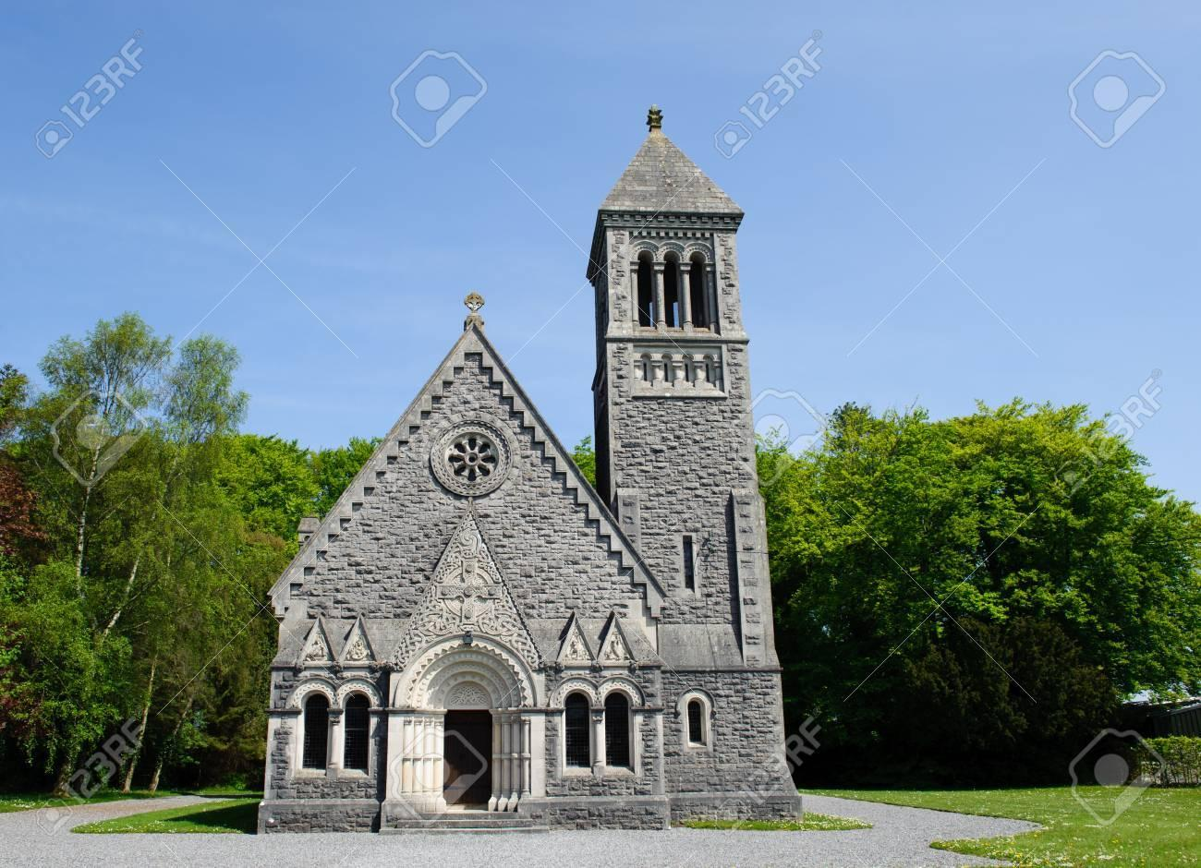
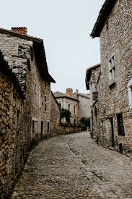
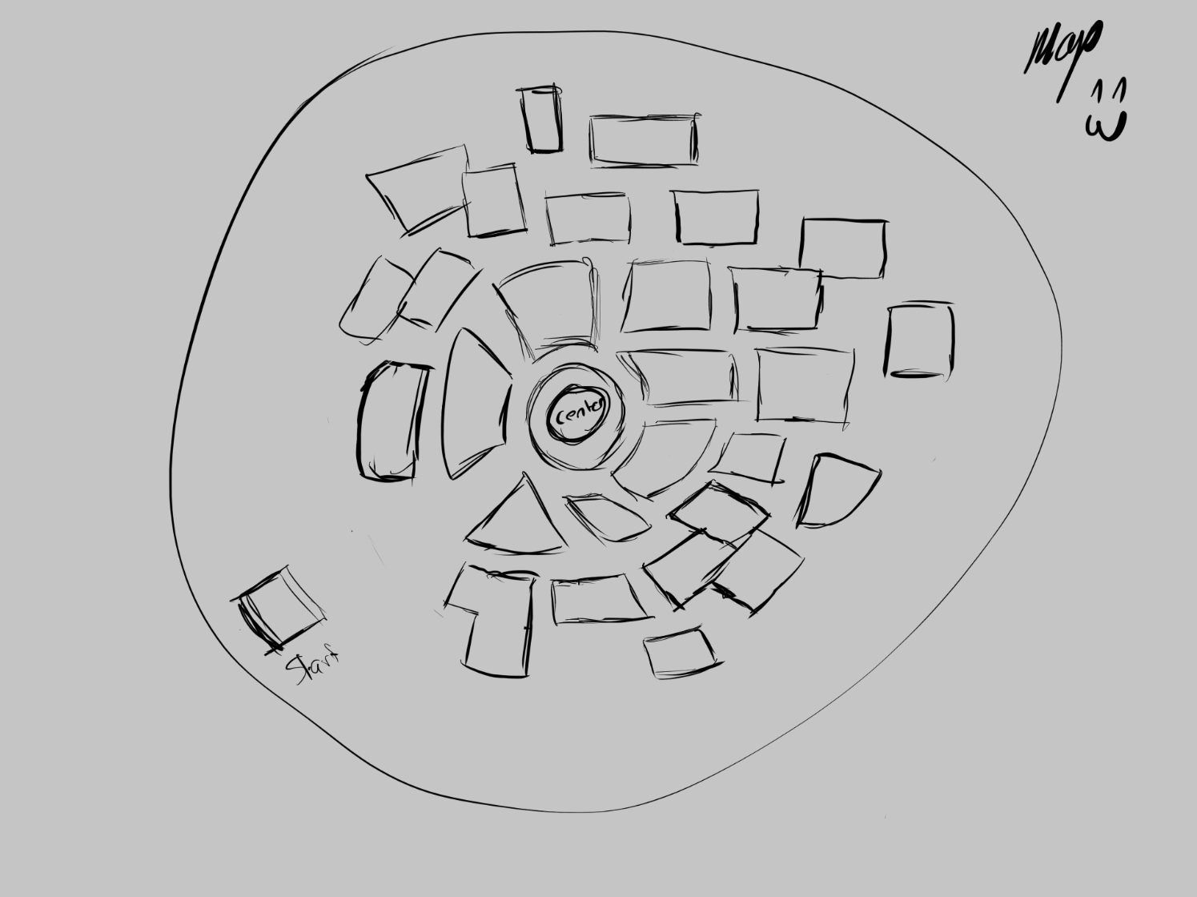
Victorian Gothic Setting
Small non-linear map
Church (with a bell tower)
4-6 houses that will be copied over the map
Cobble roads with street lamps
Iron fence are the world barrier
Some trees, bushes and rocks to the external forrest
Town center (with feature pieces eg. statues, fountain or market place)

Slide 5
Game Mechanics
Player Character:
First person Perspective
Move in 3D space
Cannot jump or run.
Player HUD
Vitality %
Alerted authorities message
AI: Villager
Walks around randomly
Alarmed state running away from player to authorities
AI: Enemy (Officer)
Move in 3D space
Cannot jump
Is faster than the player
Level Timer
Sun Rises
Bell Tolls
Player must return to church before timer runs out (sun has risen)
Scoreboards
Pause / Level Complete Screen with Stats
Game Over screen
Notes:
Find out the intention behind “caught state” - fred
Add into details that the oficer will spawn at a specific building (maybe police station / sherrif office) and then begin seeking the player. - fred
When victim runs away, they will despawn / go back to wondering state once they get far away enough from player and out of line of sight.- fred

Slide 6

Art bible

Slide 7
Moodboard

Slide 8
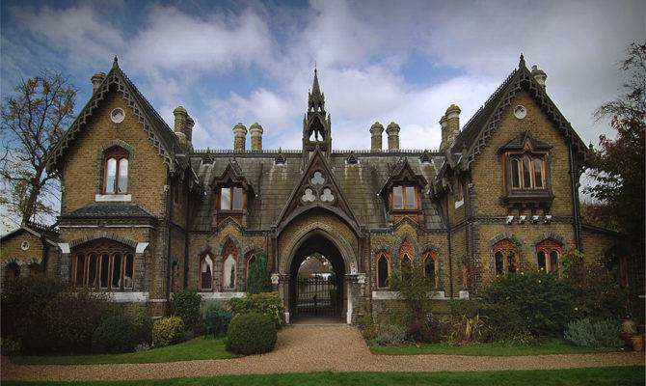
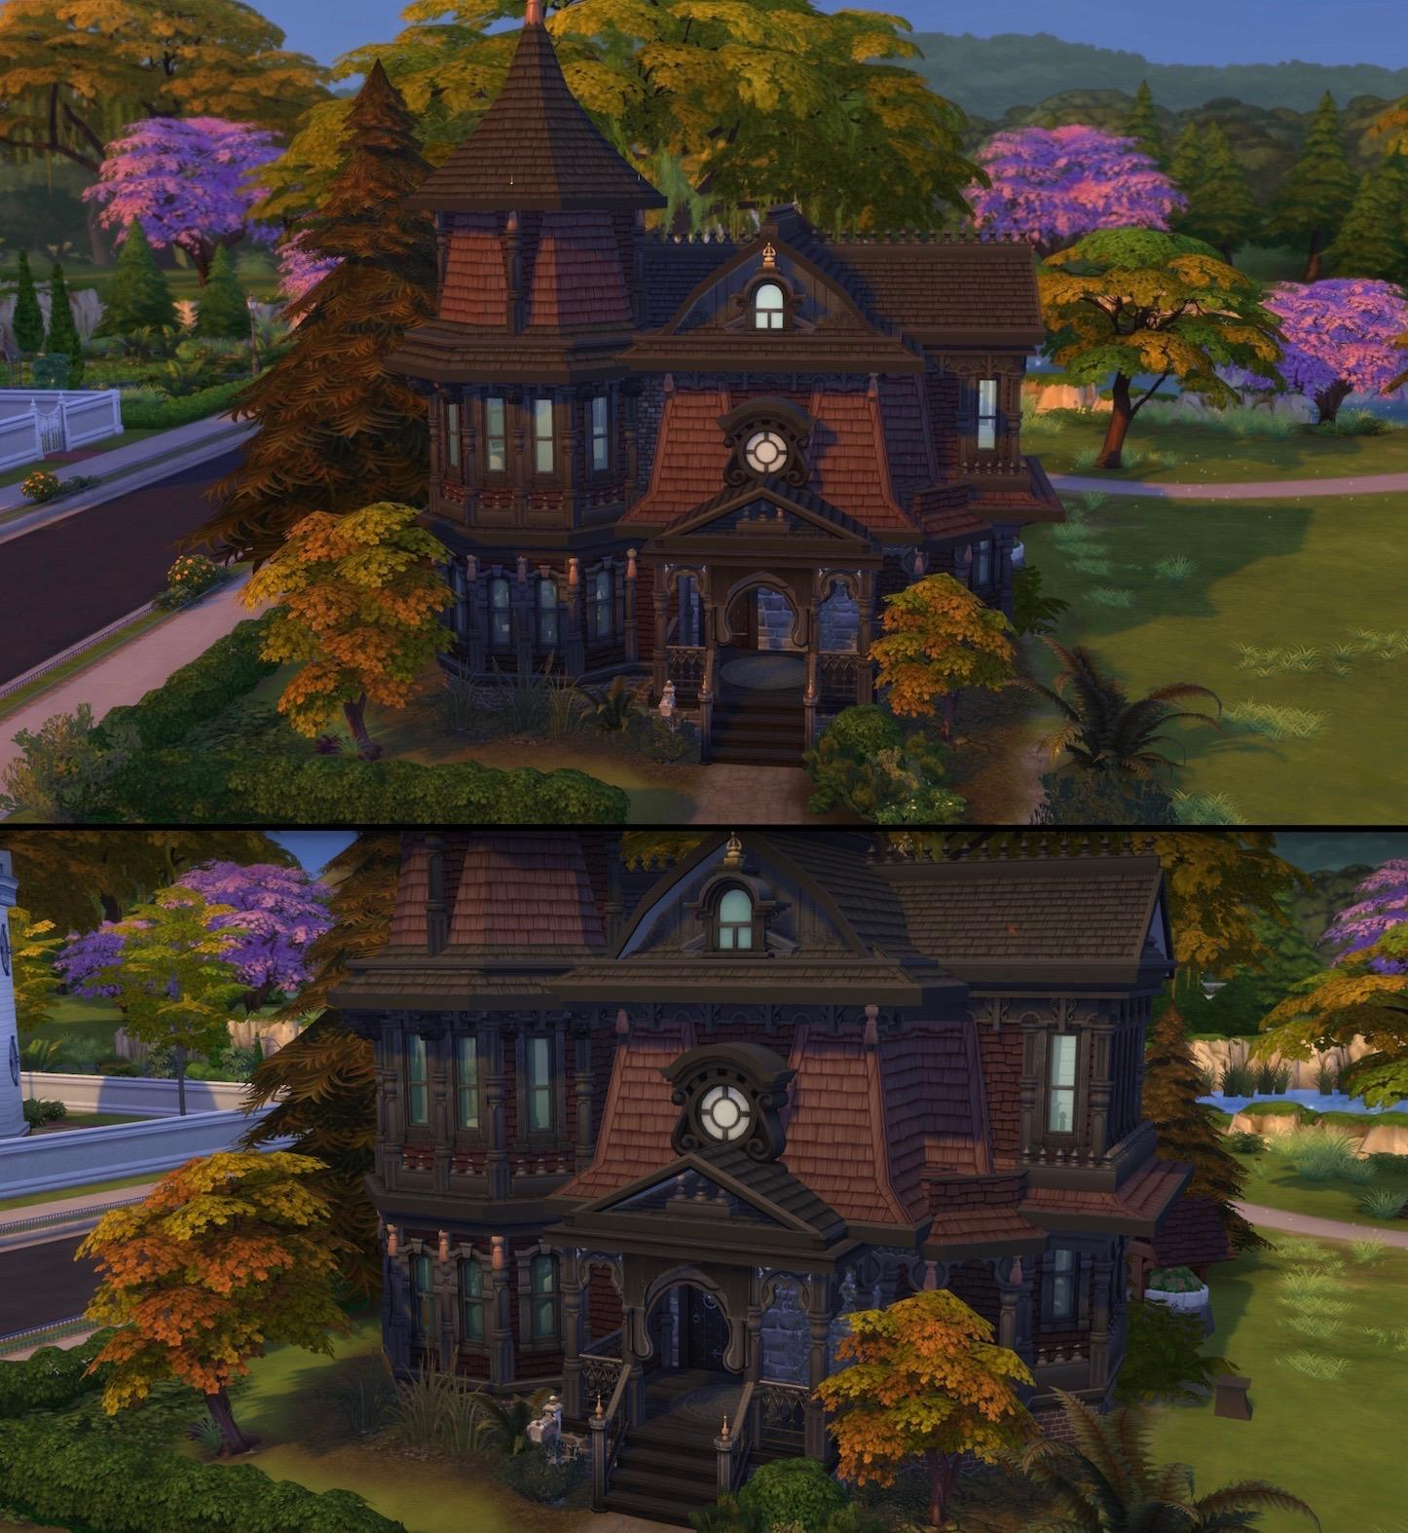
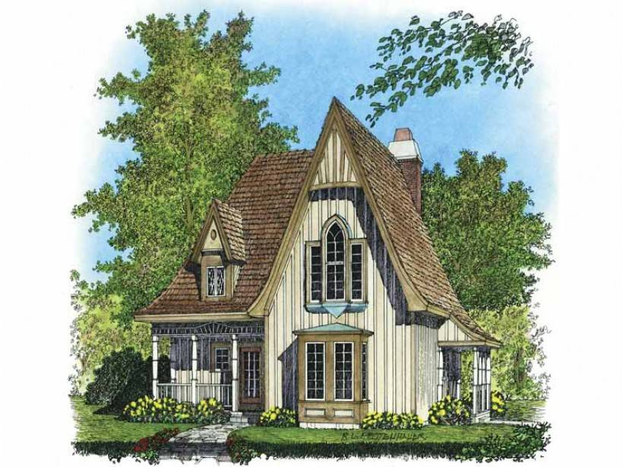
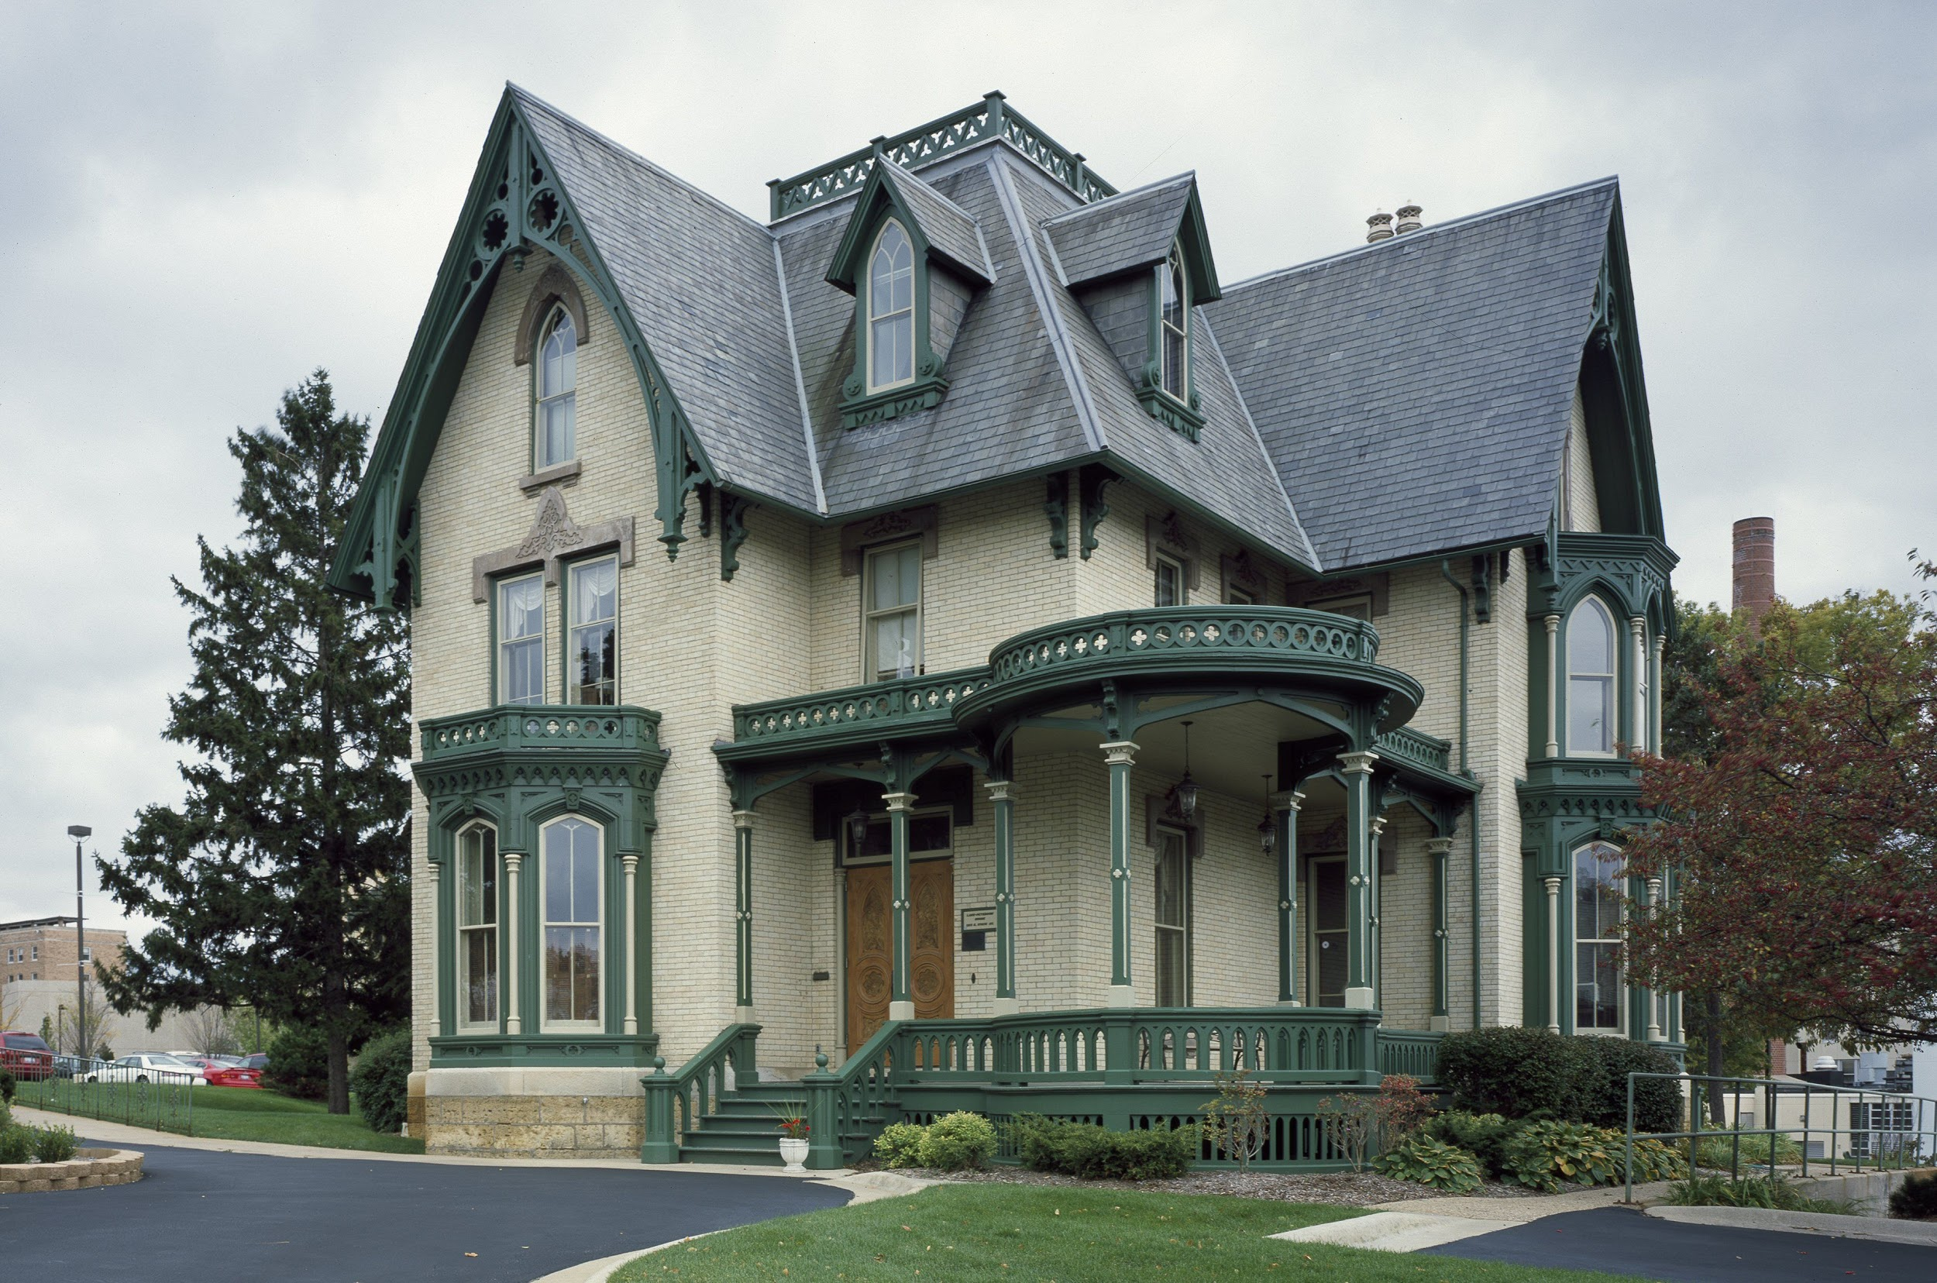
Houses
High pitched Roof (gabled roofs)
Pointed Arches
grouped colonettes
Heavy Stonework
Bay Windows
Lots of height
Gable Windows
Roof tiles

Slide 9
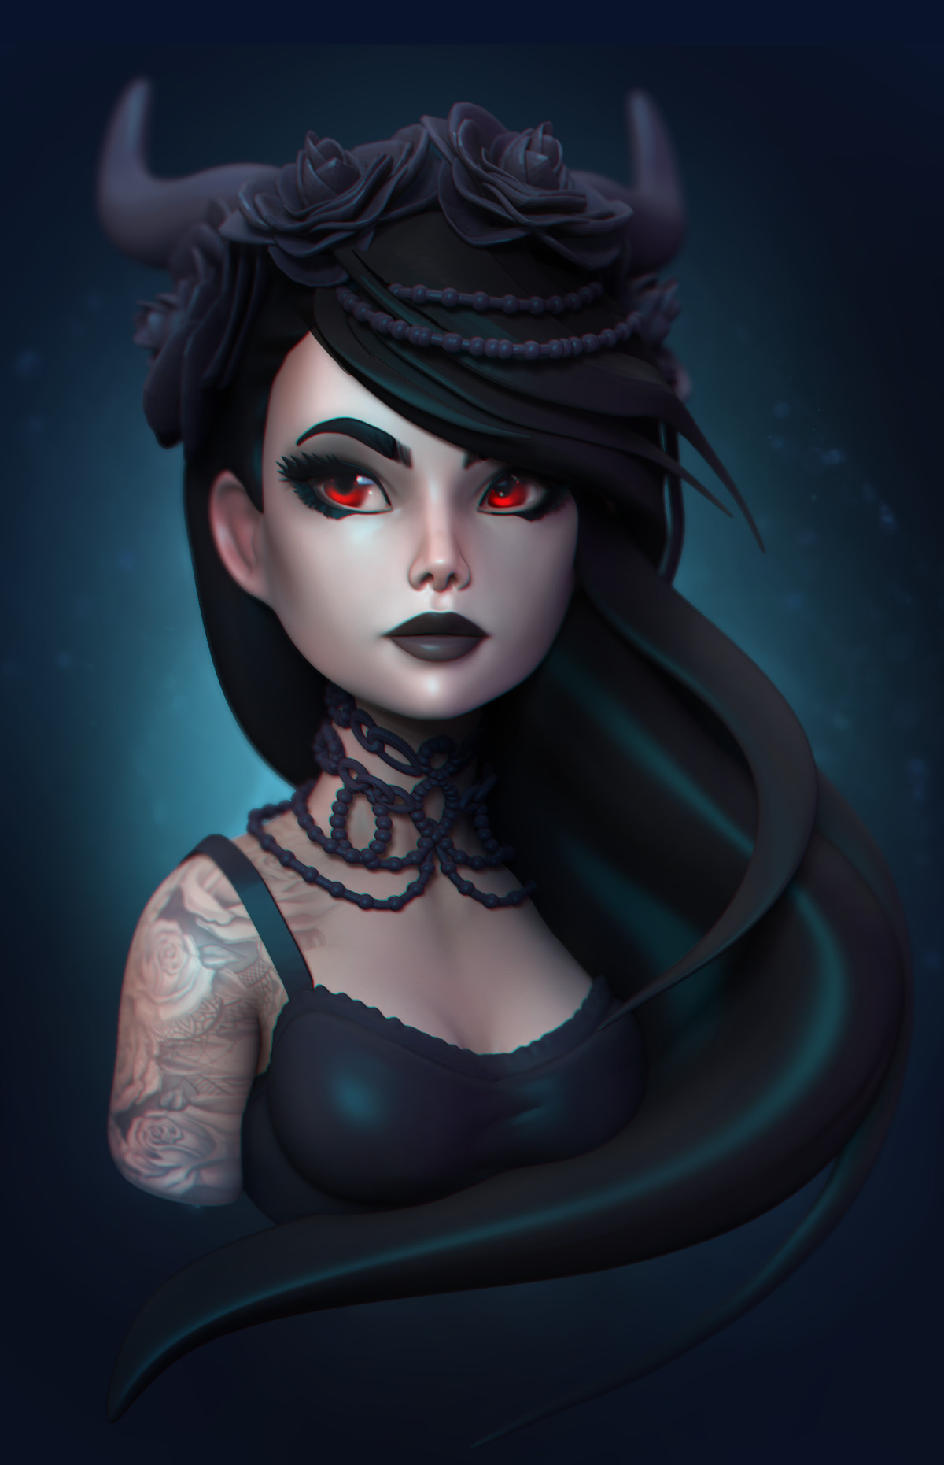
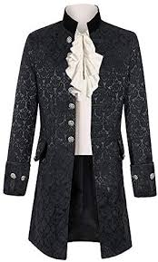
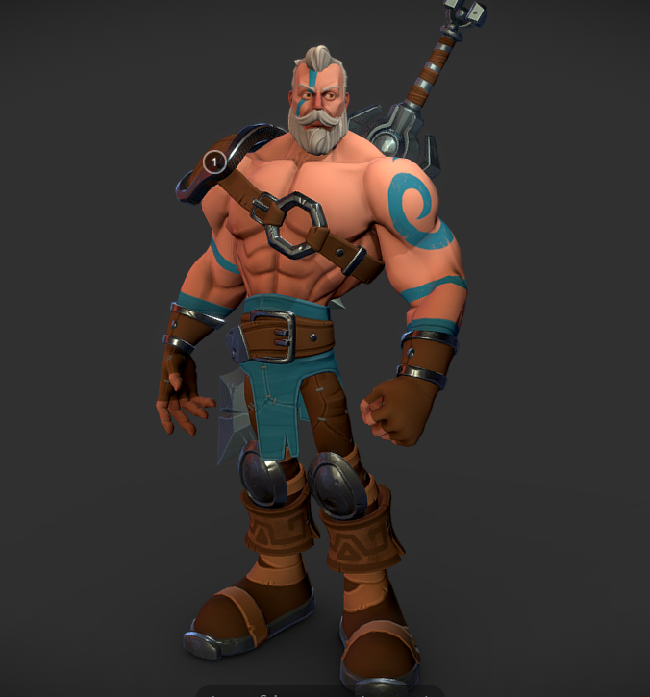
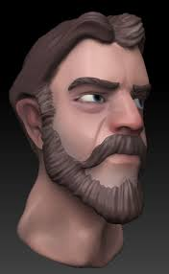
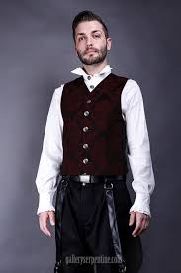
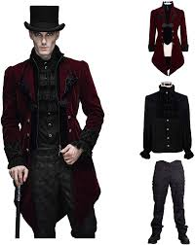
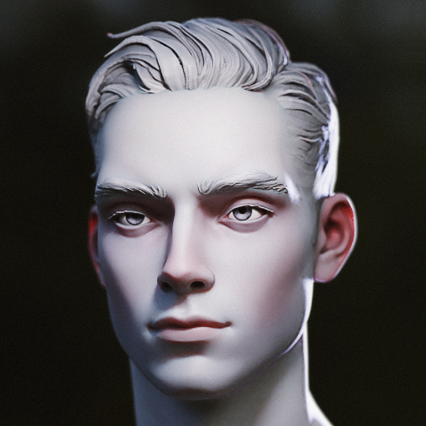
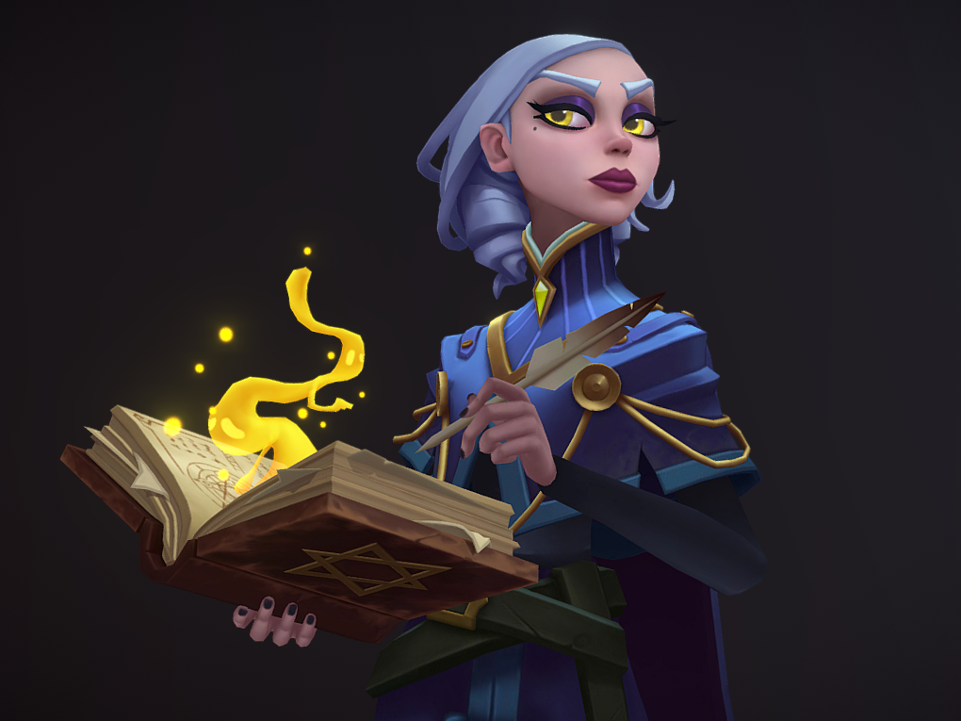
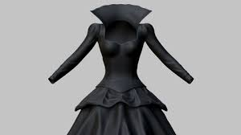
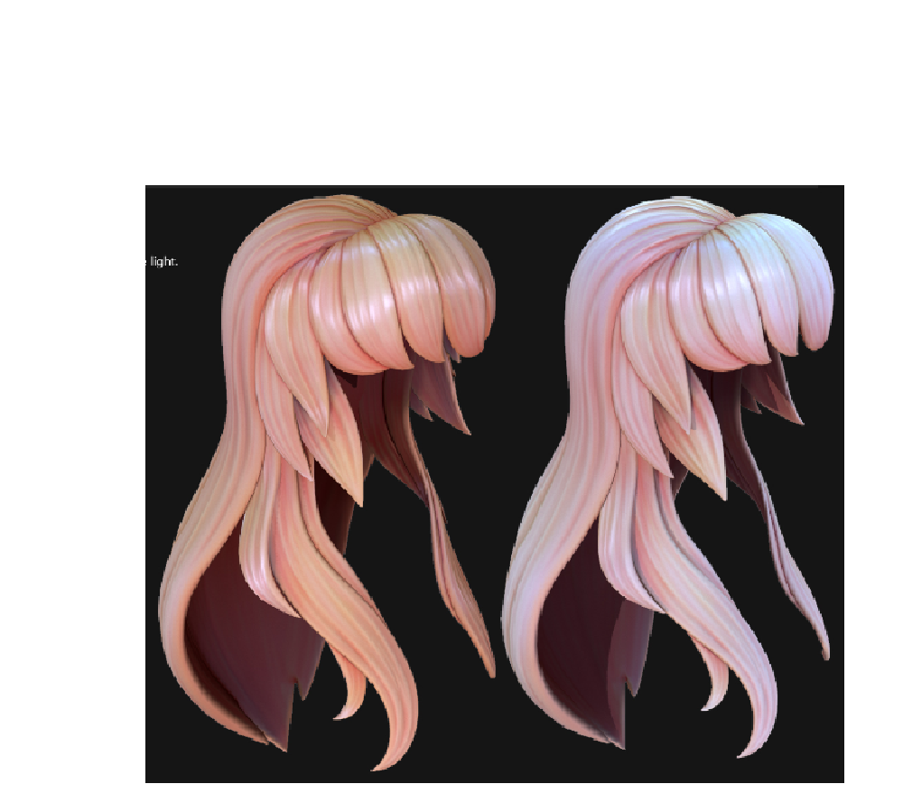
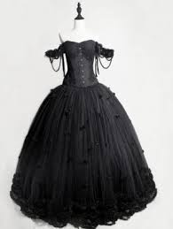
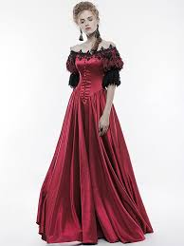
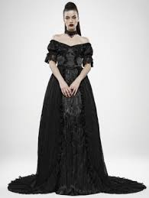
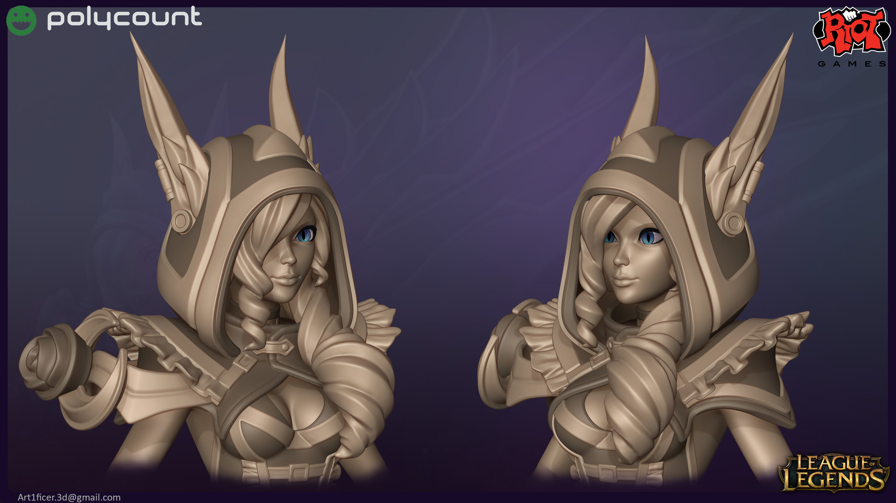
character (npc)

Slide 10
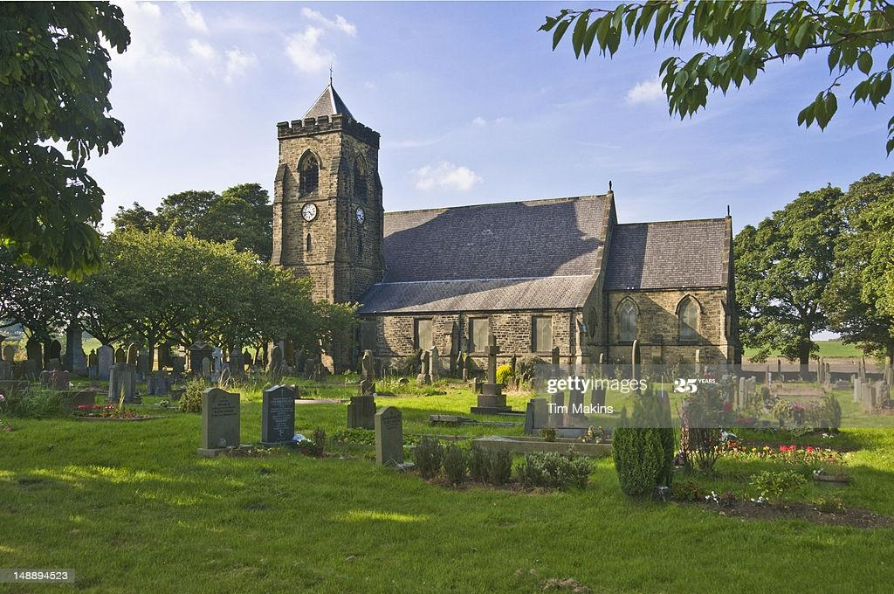
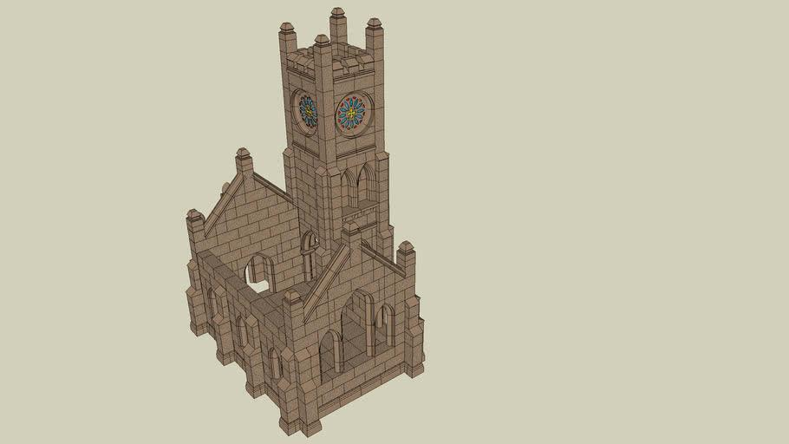
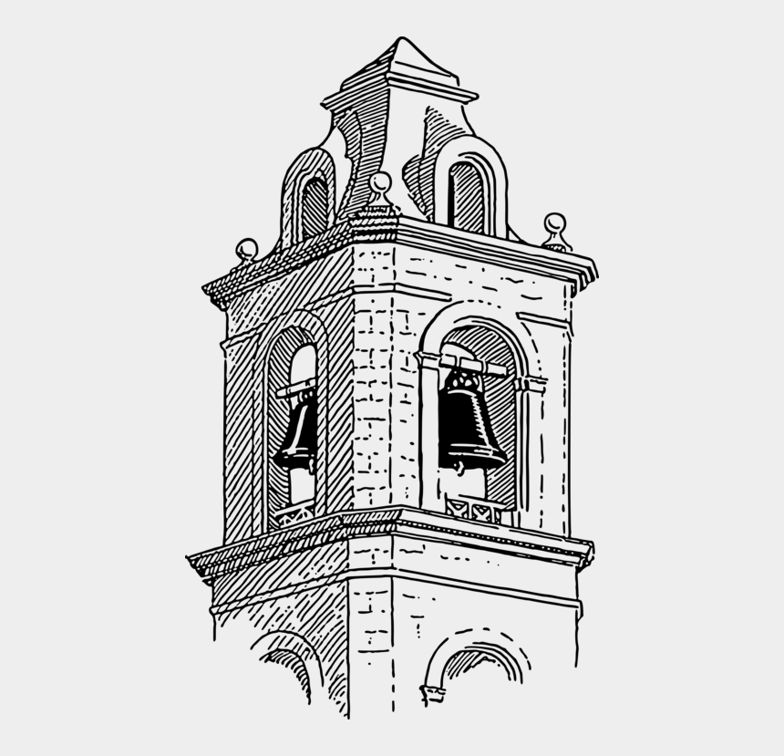
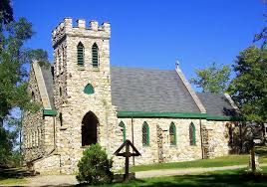
church
Stone brick work
High bell tower
Gabled roof
Roof tiles
Arche windows
Arche door
Offset bell tower Open Bell area

Slide 11
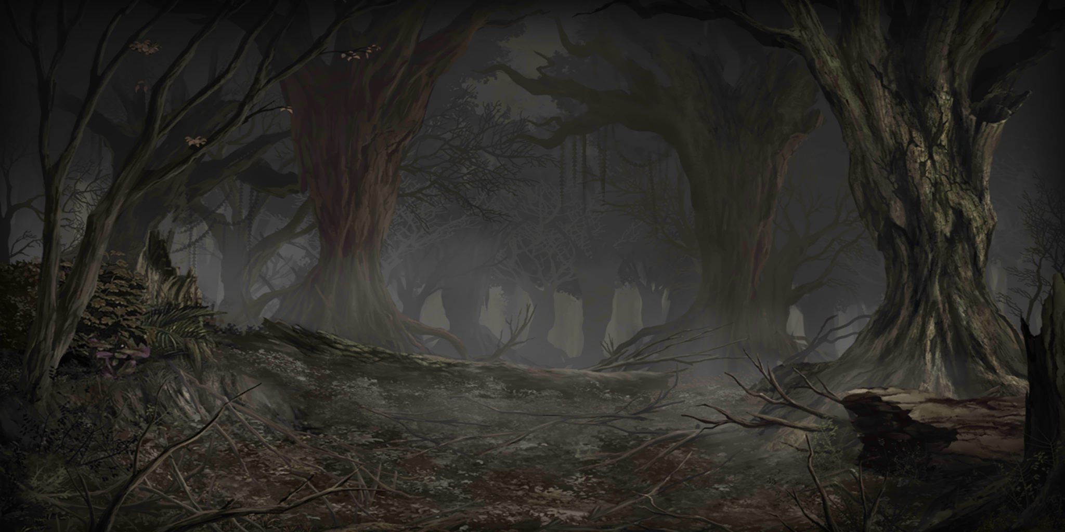

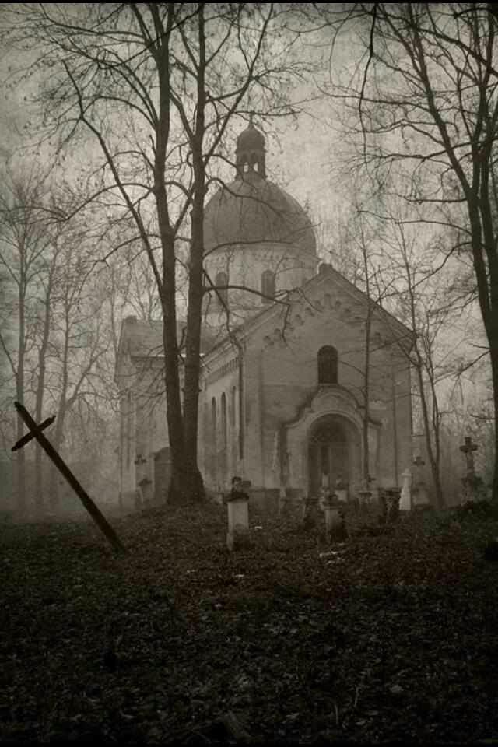
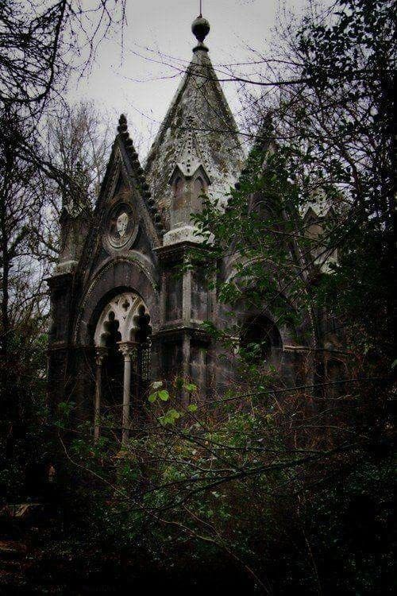
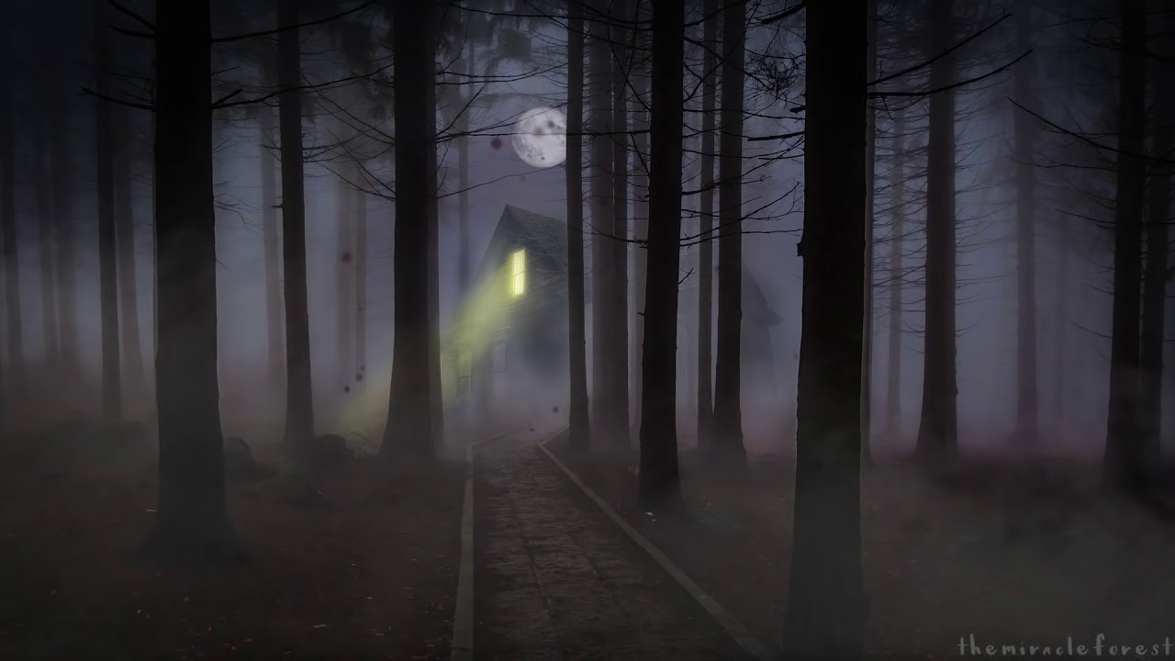
World border
Foggy
Overrun by plants
Dark

Slide 12
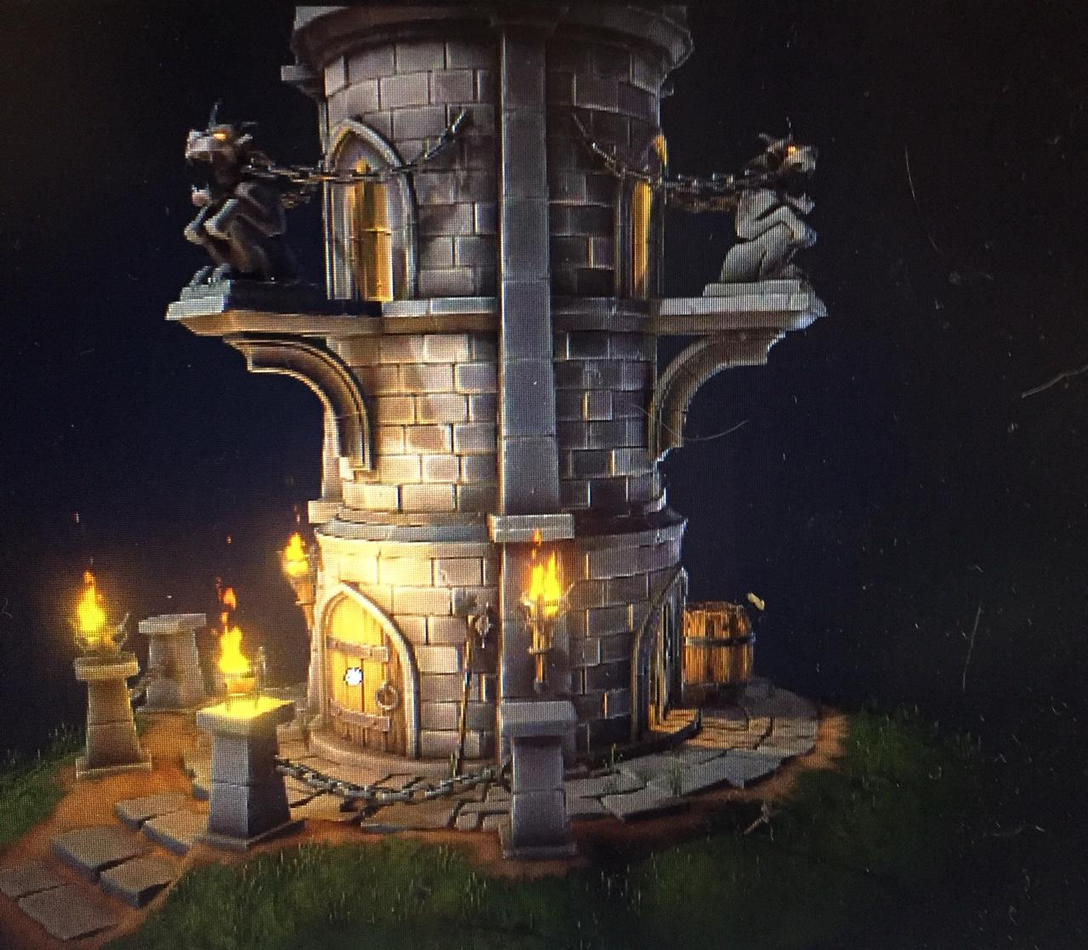
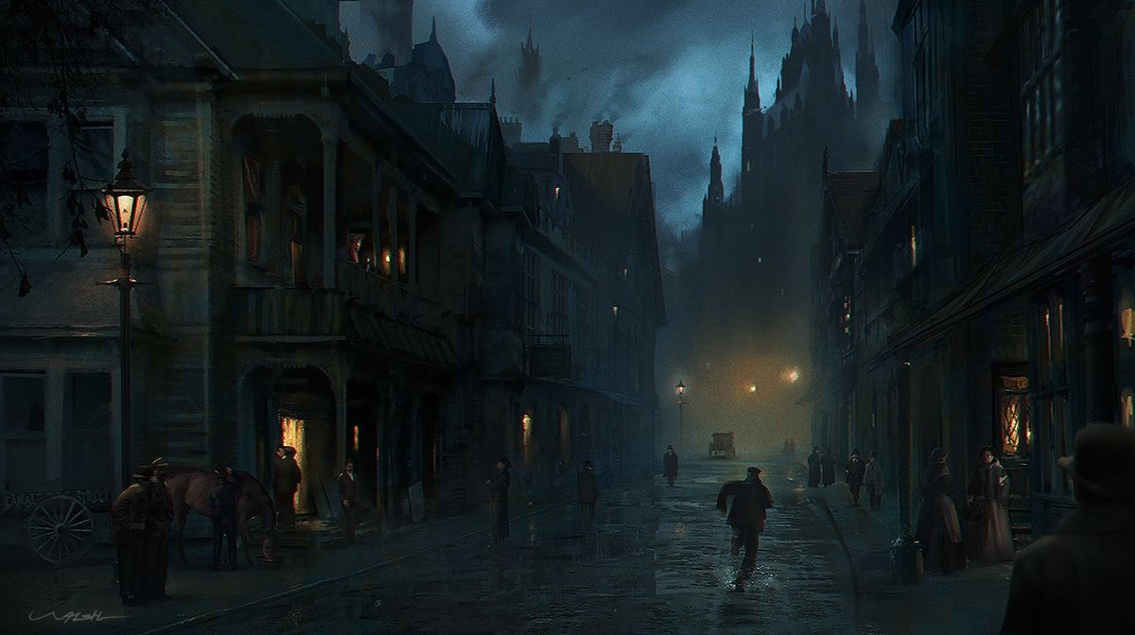
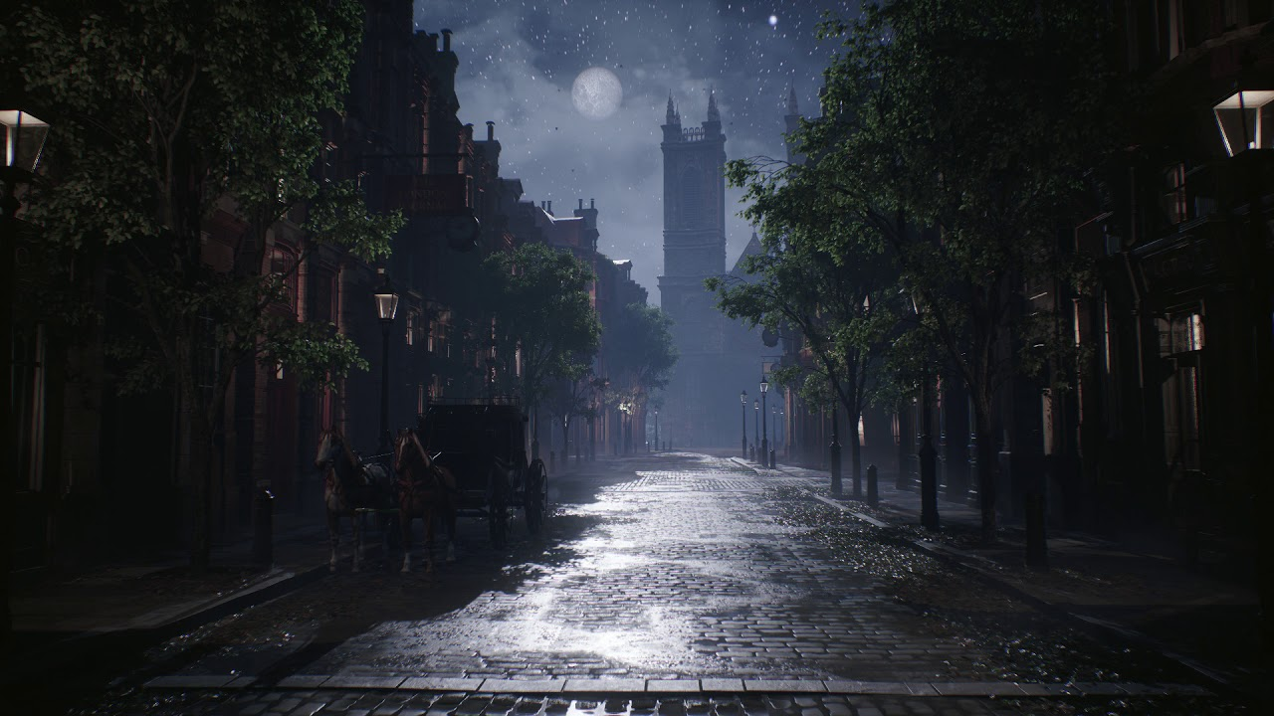
town
Cobble Roads
Iron Street Lamps
Dark and Moist
Ambient light from buildings
Foggy
Empty

Slide 13
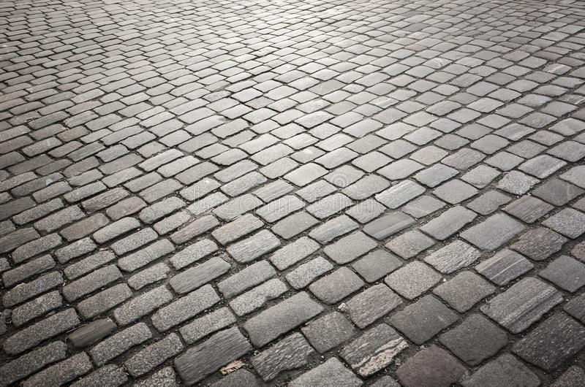
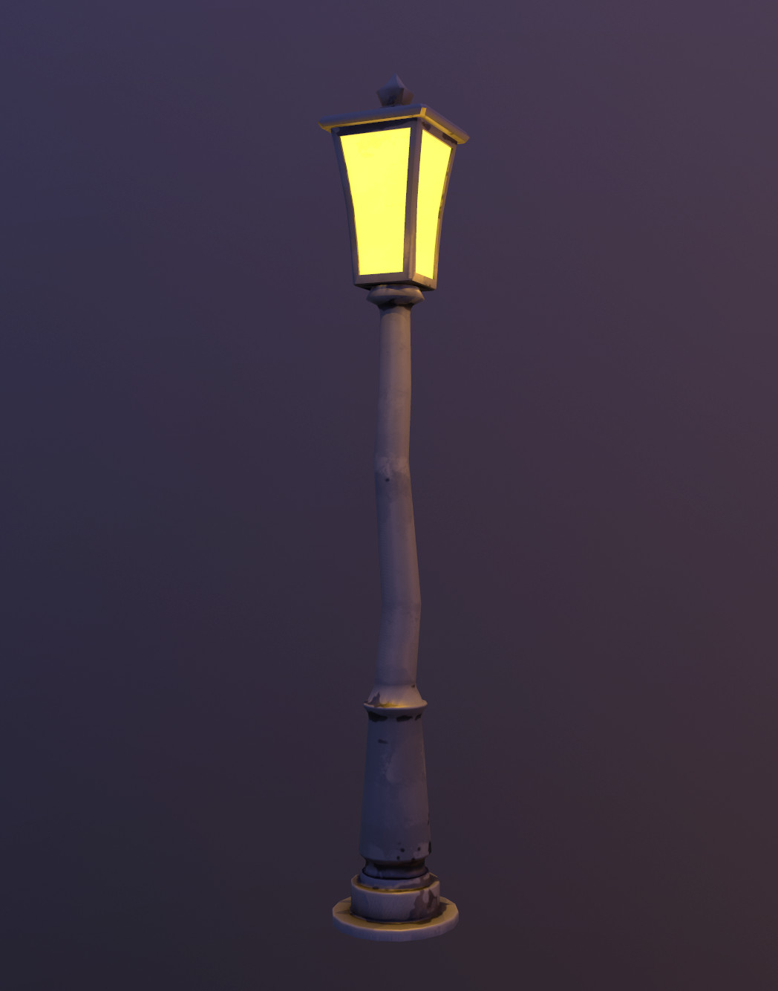
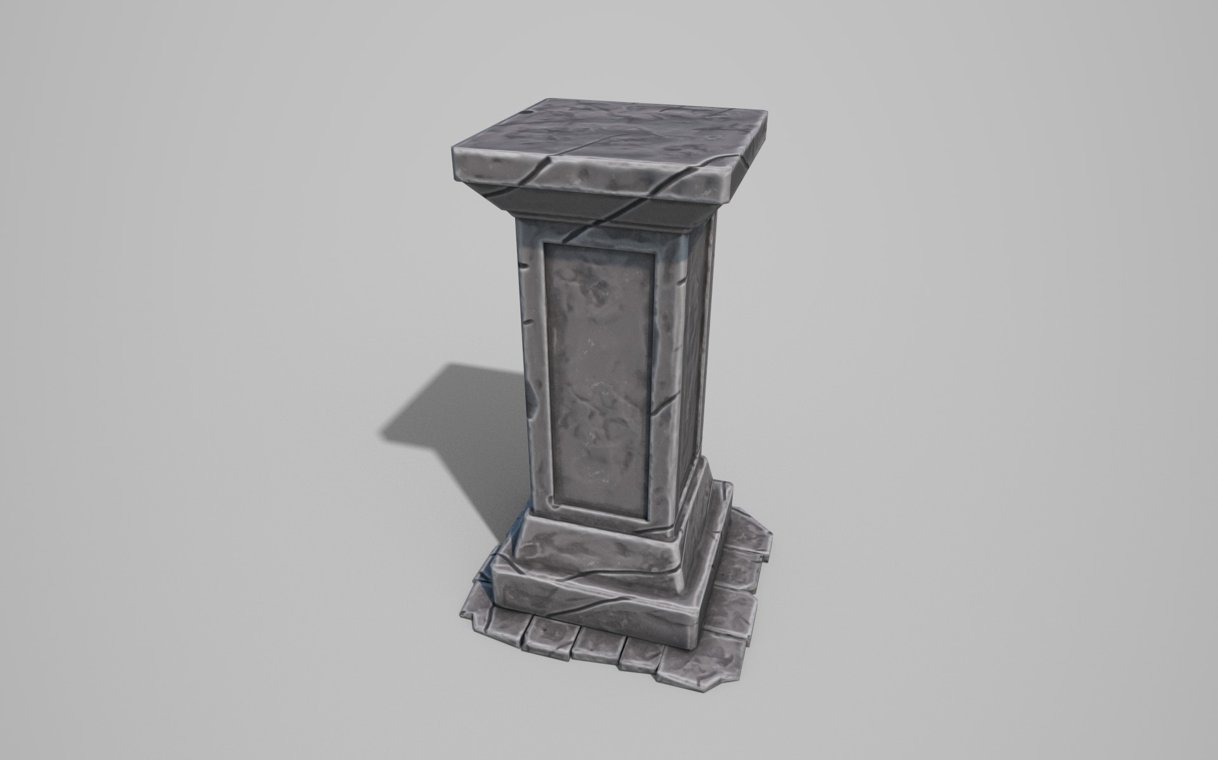
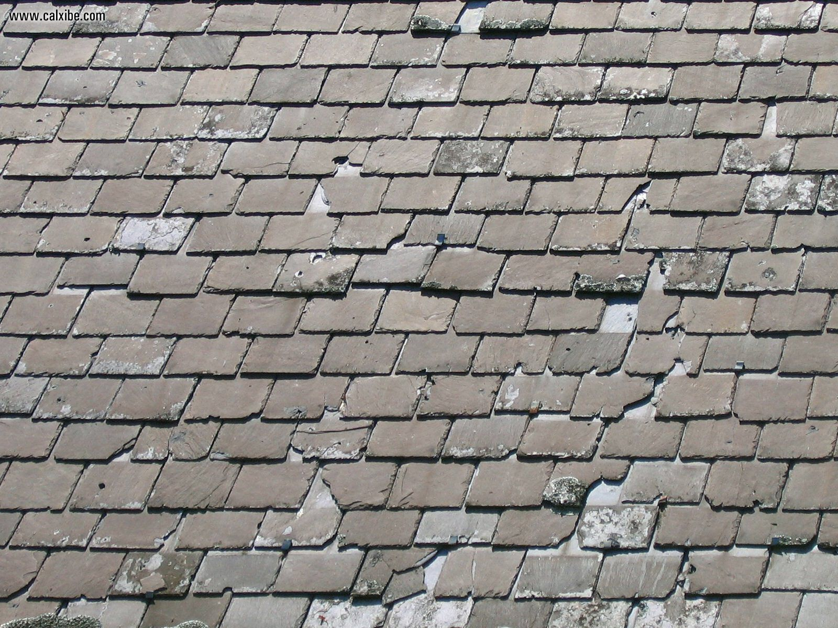
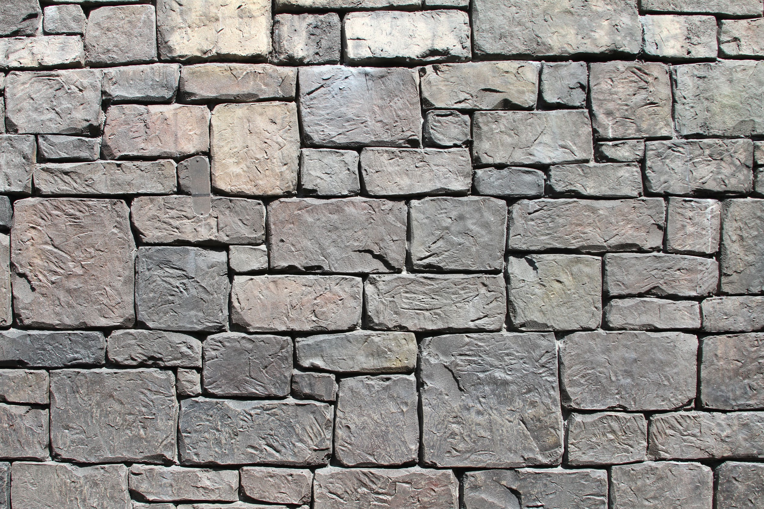
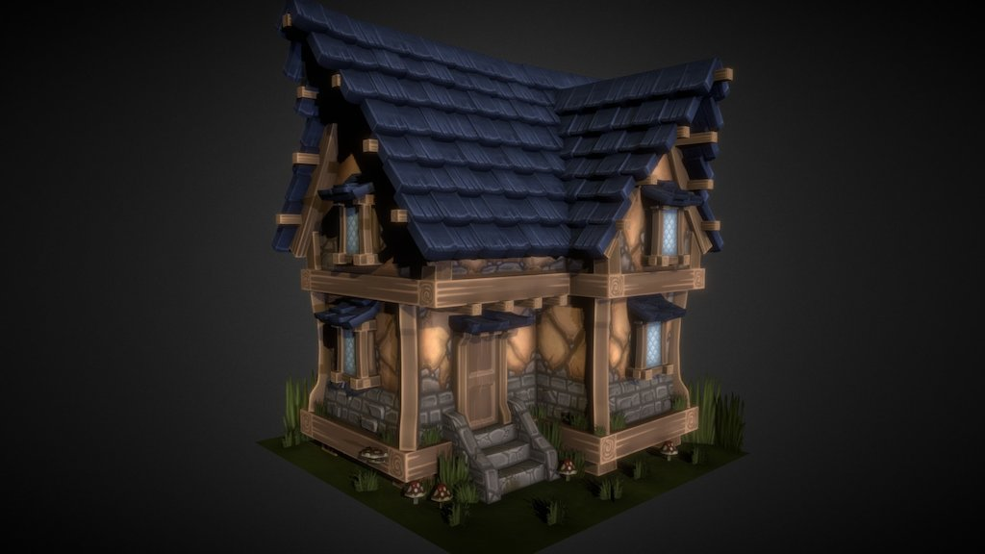
Texture guide/ style guide (stylised)
Stone road ways
Roof tiles house stone work
Stylized art is a form that has moved away from natural forms and shapes. ... Therefore, the art appears similar to the natural state while also looking more dramatic or abstract.
The texture will be based lots of 1850 stone work with bits of iron parts scattered around the map

Slide 14
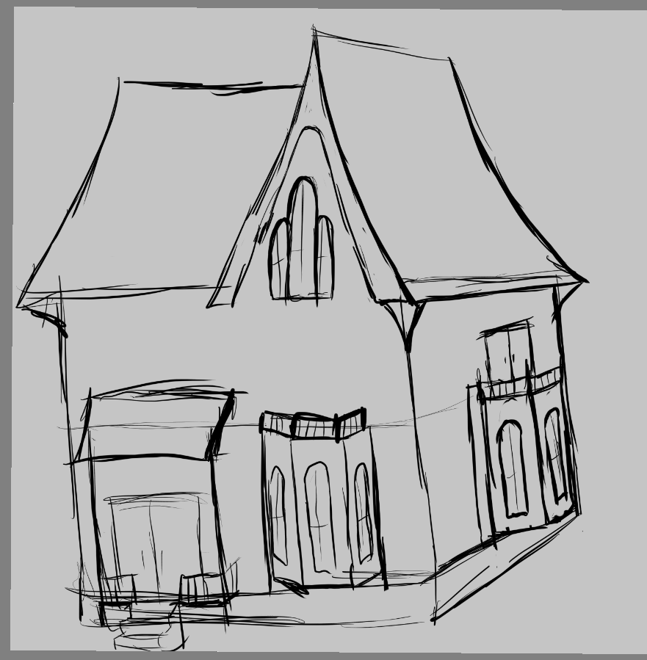
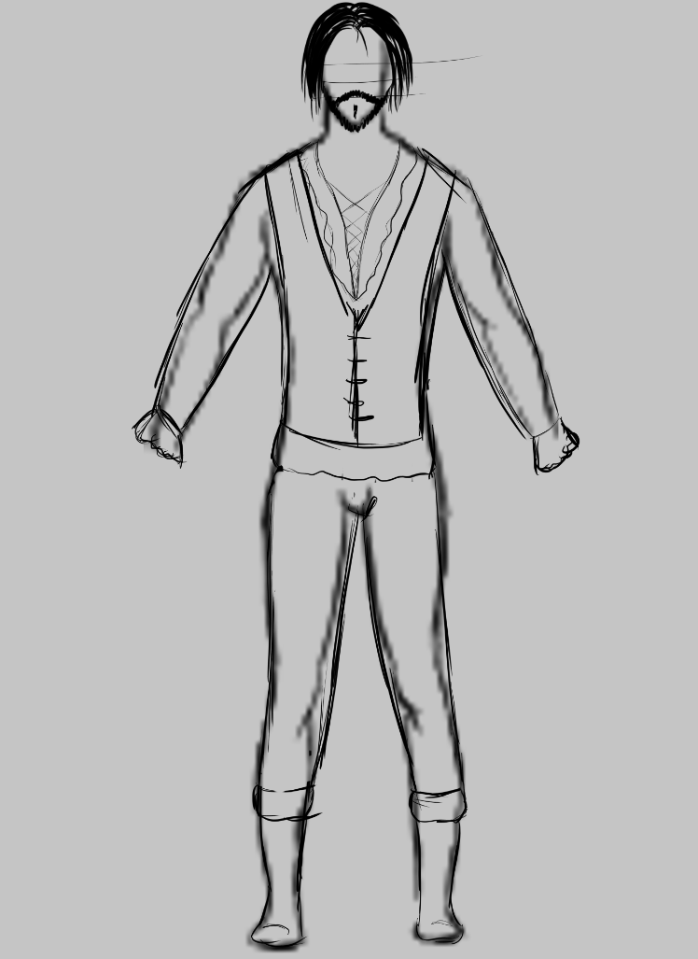
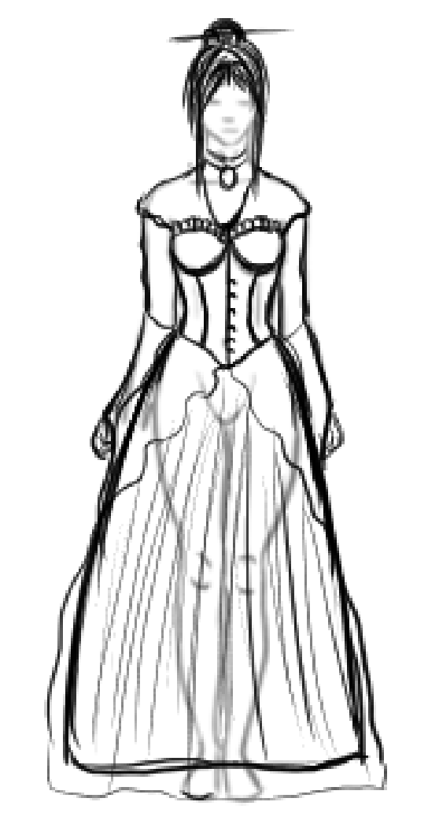
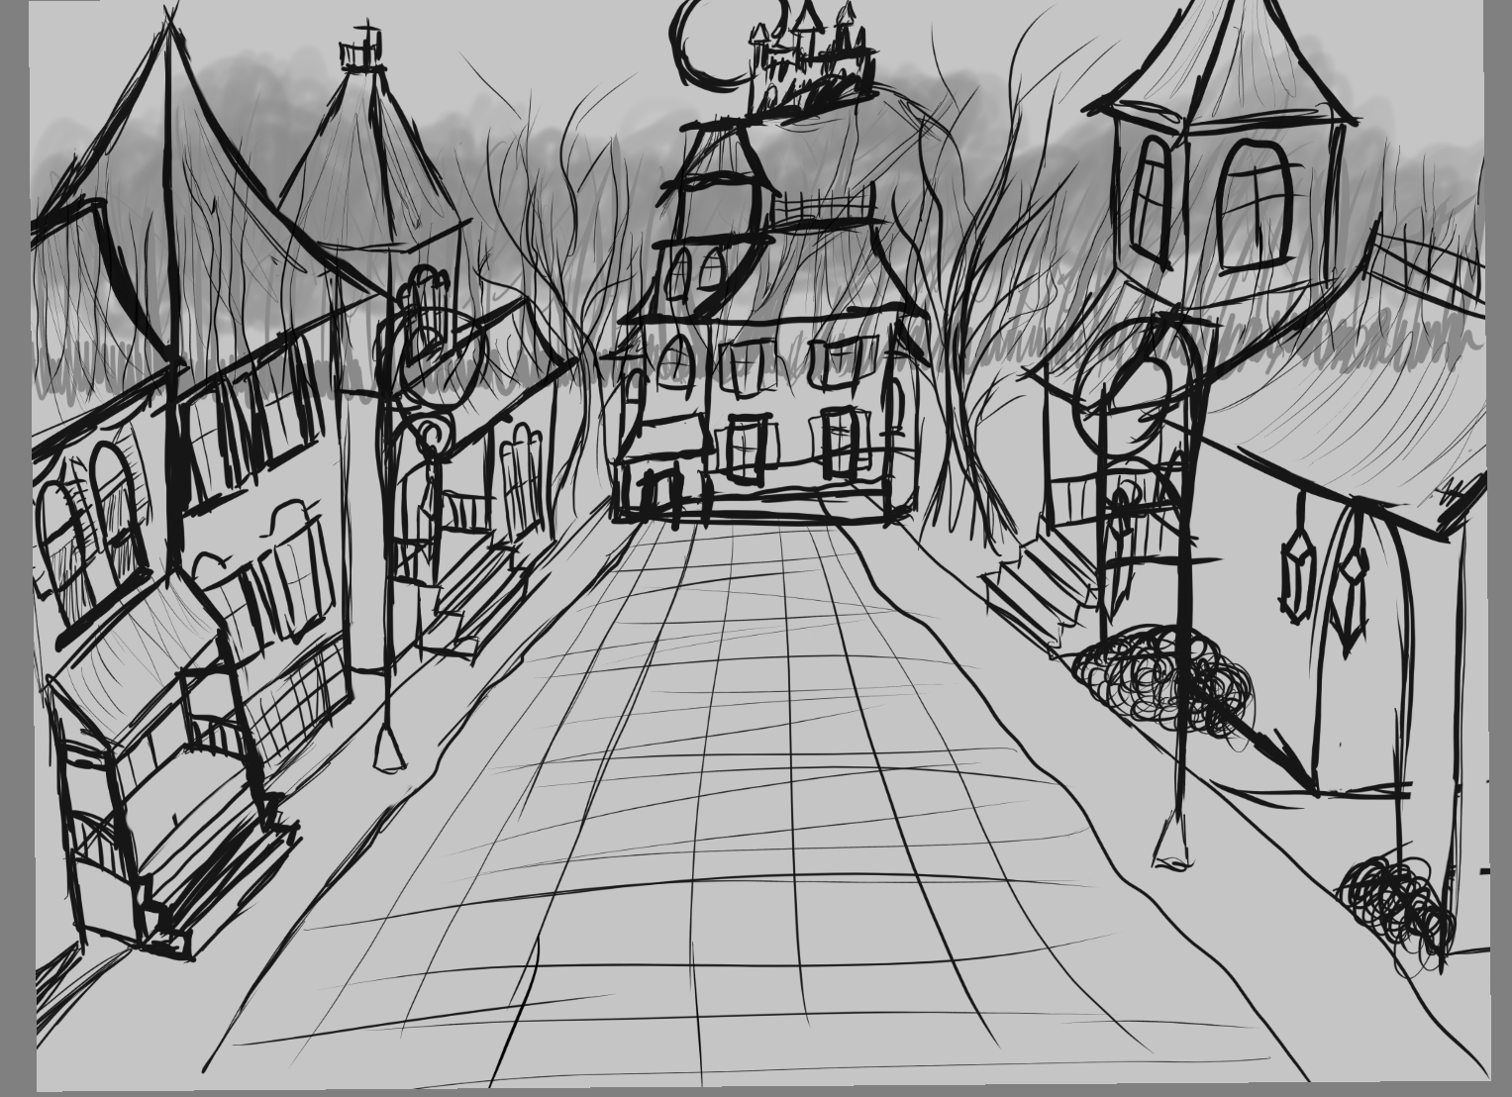
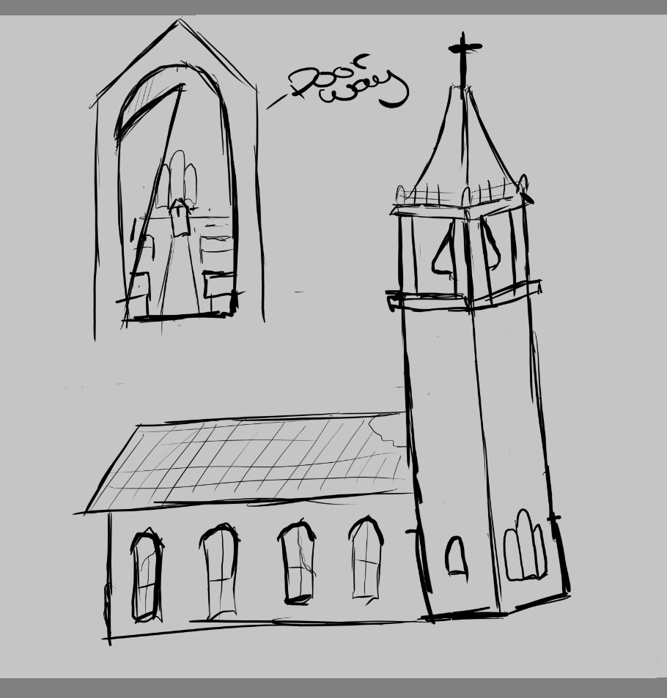
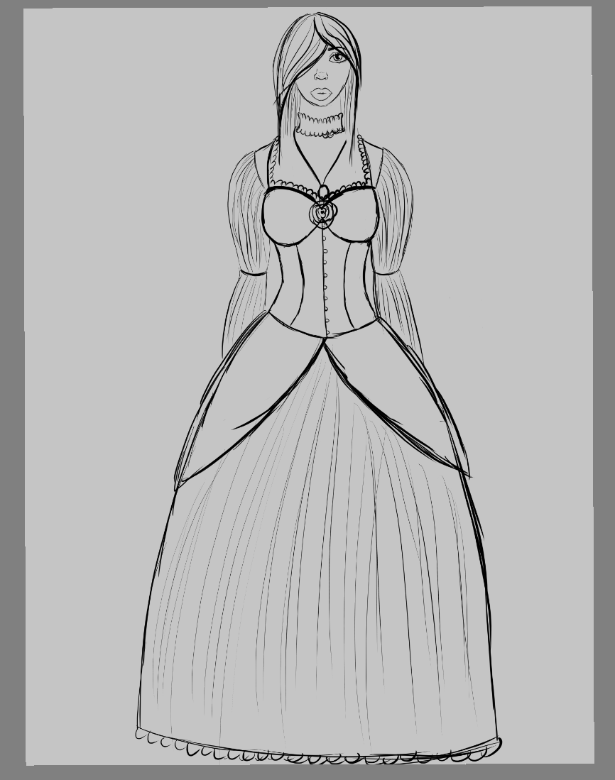
Concept art

Slide 15
Sounds
Church bell for timer
Sound effects for Menu,
Water feature?
Wolves, crickets and other animals
Player or NPC footsteps?
Player catches NPC sound “Aargh!”
NPC cry after foiled attack “Help, I’m being attacked”
NPC authority shouting to Player, “Stop”, “Get him” etc
Player dies Sound effect
Player get to church in time Sound effect
Player doesn’t get to church in time Sound effect

Slide 16
Art team task
Fill out the mood board and art bible
Block out of models
House models (4-6 models )
Character models (villager, Officers)
Feature models (models to be place around the map to help identify where you are on map
Forest models (some trees, bushes and rocks)
Floor tiles, fence and lamp
3D Tiles
Notes:
Whats with the disjoint “3D Tiles” ? - fred

Slide 17
Programmer team
Make a first person controller
Make an attack system
Scoring system
NPC movement, logic and stat
Make and design a UI system
Game over screen
day/night cycle
If we have time each day gets harder
A progression state (if we have time)

Slide 18
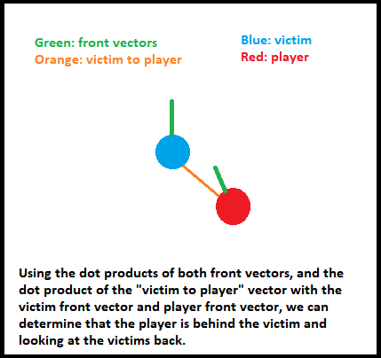
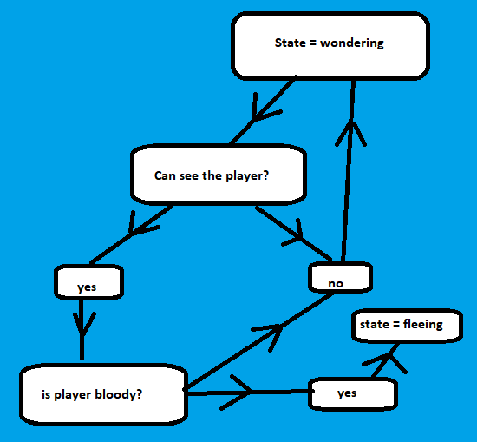
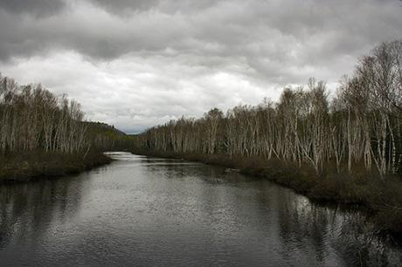
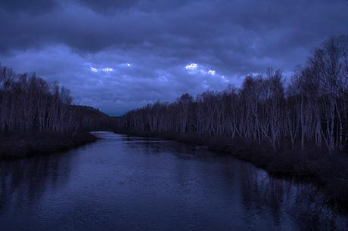
Technical examples
Attacking from behind is done using vector dot products.
Simple state machine based civilian A.I.
Manipulating global lighting levels and color to simulate sun rising and falling with overcast skybox.

Slide 19
Project scope
Contained map - 200m x 200m
6 modular buildings, 1 church hero model, 1 fountain hero model?
No player model
2 Types of NPCs - Villager & Authority
Minimal NPC animations and states
3 Canvases: Menu, Level Complete, Game Over
Minimal HUD with text, no animations / graphic widgets

Slide 20
Risk Assessment
Art
Enough time for building models, ground textures, NPC modelling, canvas screens and HUD effects
Programming
New to some aspects of Unity
Bugs
Production
Time, Cost, Quality constraints
Information Flows, Risk Mitigation
Notes:
Changed “get high scores!” to “survive as many nights as you can” - fred
Changed “authorities will dispatch you with fire!” to “if you are reached by the authorities, you will be killled” - fred
Changed “local church” to “local abandoned church” - fred
Changed “level” to “night” - fred

Slide 21
Roadmap
Beta (27th Nov - 2nd Dec)
QA - bugs / user feedback etc
Level polish with textures, volumetric effects, high quality models etc if that is what is intended for the game
Gold (2nd - 4th Dec)
Finish all deliverables, documentation, square off all project management tasks.
Project Due 4th Dec
Pre-Production (2nd - 10th)
GDD, TDD & Art Bible
Individual + Group Presentation
Greybox (11th -16th Nov)
Level greyboxed
Get a feel for the game space due 16th Nov
Alpha Stage (17th - 27th Nov)
Level has all mechanics working
Feature complete build by 27th Nov

